Slide 1
Linking Files and
Front-End File Structures
Front-End Web Development

Slide 2
HTML Tables Change Log FEWD 3.0–3.1
Below are the specific changes made in this lesson.
Returning Instructor Directions:
Click on the hyperlinks below, and it will direct you to the specific slide.
Copy the entire slide, and paste in your existing curriculum deck.
None- No changes from 3.0 - 3.1
Share how the lesson went through our Instructor Lesson Exit Ticket - the Curriculum Feedback form: http://ga.co/curriculum-feedback

Slide 3
Websites Need More Than Just HTML
Resource | Syntax
Style sheets | <link rel=”stylesheet” href=”css/style.css”>
JavaScript | <script src=”js/main.js”></script>
Images | <img src=”img/tacocat.png”>
Videos | <video src=”vid/ad-campaign.mp4”></video>
Other pages | <a href=”https://google.com”> Google </a>
Notes:
TEACHING TIPS:
The CSS and JS links are especially tricky, because CodePen will be doing this automatically. This could be a good opportunity to demo a full-featured text editor and opening HTML files in Chrome.

Slide 4
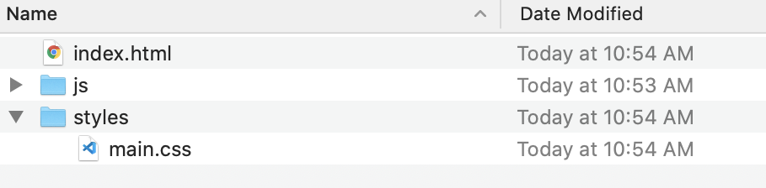
Relative Paths: Folders
Relative paths are written in relation to the file making the reference.
In this example, a relative path from index.html to main.css would look like this: <link rel="stylesheet" href="styles/main.css">.

Slide 5
Relative Paths: Single Dot
This same example can be written in a slightly different way:
<link rel="stylesheet" href="./styles/main.css">
The ./ tells the browser to look for the file starting in the current directory.

Slide 6
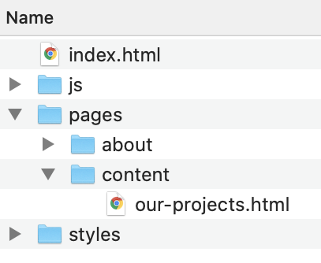
Relative Paths: Double Dot
Double dot notation references one folder above the current directory.
This is how you’d link index.html from our-projects.html (notice how they chain):
<a href="../../index.html">.
Translated into English, this says, “Go up one folder from content to pages, then up one more folder from pages to the root level, and find a file called ‘index.html.’”

Slide 7
Absolute Paths: Starting /
From index.html, you can reference our-projects.html relatively:
<a href="./pages/content/our-projects.html">
Or you can reference it absolutely:
<a href="/pages/content/our-projects.html">
Notice that the only difference is the dot in front for relative and the slash for absolute. Absolute paths start in the root directory of your project. You want to use relative links whenever you can.

Slide 8
Absolute Paths: HTTP/HTTPS
The main use case for absolute paths is when they are external resources like images or websites. When you see the http:// or https:// protocol in front, it’s time to reach for absolute links.
You'll generally see them with anchor tags, like this:
<a href="https://google.com">Google</a>
But, when linking between HTML pages within the same site, stick to relative:
<a href="../index.html">Go to Homepage</a>

Slide 9
Common Patterns With Paths
Relative path for an image, typically in a subfolder:
<img src="images/tacocat.png"/>
Relative path for a background image in CSS. Images and style sheets usually both live in subfolders, so you have to go up one and into the images folder:
background-image: url(../images/tacocat.png);
Linking style sheets, which are typically in a subfolder:
<link rel="stylesheet" href="styles/main.css">
Linking external JavaScript files, also typically in a subfolder:
<script src="js/app.js"></script>
Notes:
TEACHING TIPS:
You may want to draw out the typical folder structure they should use for projects from here on out — “index.html” at the root, folders for images, styles, and JS.

Slide 10
What Does Each of These Paths Mean?
<link rel="stylesheet" href="styles/main.css">
<link rel="stylesheet" href="../styles/main.css">
<link rel="stylesheet" href="/styles/main.css">
<link rel="stylesheet" href="./styles/main.css">
Notes:
TEACHING TIPS:
You can use the whiteboard to draw a folder structure matching the linked destination path. Being able to visualize the folders will be helpful in understanding relative paths and the concept of parent/child up/down folders.

Slide 11
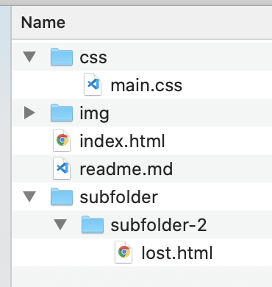
Practice With Paths
15–30 minutes
Create a series of files and folders that match the image on the right.
Download any image you want and put it into img.
Use it as a background image in your CSS.
Link your style sheet to your HTML using a relative path.
Create a working relative link from index.html to lost.html.
Create a working relative link from lost.html to index.html.
Experiment with more HTML and CSS.
Notes:
TEACHING TIPS:
This could be a code-along or a self-directed activity. It could also be an altogether optional piece if you run the class completely in CodePen. CodePen projects let you emulate a folder structure in the browser, which would be a nice option for this.
Another option would be take the cookie recipe from Week 1 and refactor with uploading/using the path in their code.

